Slide 1
Software Project Initiation
Lecturer: Ngo Huy Bien
Software Engineering Department
Faculty of Information Technology
VNUHCM - University of Science
Ho Chi Minh City, Vietnam
nhbien@fit.hcmus.edu.vn

Slide 2

Objectives
To create and evaluate a project proposal.
To create a project vision and scope document.
To create a mockup and prototype.
To create a software requirements specification.
To create an architecture.
To create a feasibility study report.
To create a proof of concept.
To create a project charter.
To create a process definition document.

Slide 3

Contents
Project proposal.
Project vision and scope.
Feasibility study report.
Project charter.
Prototype.
Software requirements specification.
Architecture.
Proof of concept.
Process definition document.

Slide 4

References
Suzanne Robertson and James Robertson (2012). Mastering the Requirements Process. Addison Wesley Professional.

Slide 5


Team Forming
Each team has maximum of 6 members.
If there are surplus students, some teams may have 7 people.

Slide 6


Brainstorming Project Ideas
RFPs
Research idea
Products
6 members
8 hours per week / member

Slide 7
Tools
https://chatgpt.com/
https://www.trendhunter.com/
https://miro.com/
https://www.figma.com/figjam/
https://www.notion.com/
https://workspace.google.com/products/docs/

Slide 8

Products: Practical Problems
Apps on your mobile device, your most visited websites.
Trending apps on Google Play, App Store.
Open source software.
Your daily job responsibilities.
Your current obstacles?

Slide 9

2026 Project Ideas
OCR with LLM-Based Agents.
Document Autocompletion with Templates and LLM-Based Agents. (Conga Salesforce)

Slide 10


Prepare Project Proposal
Project Origins? Sponsor? Client?
Name, address, phone number?
Budget?
Problems?
Problem Relevance?
Competitors? Similar products? Business goals?
Product purchased by yourself?
Related work? Evaluation?
Stakeholders?
Can you meet with them or reach an agreement?
Business Use Cases?
Time? Cost? Feasibility? Risks?
Business Requirements

Slide 11

Selecting Evaluation Criteria and Evaluators
Criteria
Previous Slide
Asking AI
Evaluators
Human
AI

Slide 12
Evaluating Criteria
Evaluate these criteria for evaluating software project proposal.
Search extensively, and evaluate…
Search extensively, and critique these criteria…

Slide 13

Evaluating Project Proposal
Evaluate [proposal.pdf] using these criteria:
Search extensively, then evaluate the proposal.
Search extensively, then critique the proposal.
Conduct an extensive search of competitors' solutions, then critique the proposal.
Search extensively for existing solutions that can be combined to form a solution to the problem, then critique the proposal.

Slide 14

Finalizing Project Proposal

Slide 15
Prepare Project Vision and Scope
Current state, (manual) workflows, features.
Future state, workflows, features.
User Requirements

Slide 16
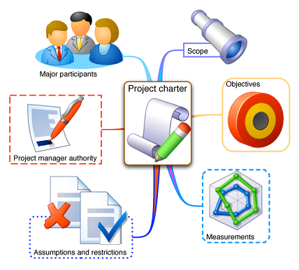
Project Charter
A document that formally authorizes a project or a phase and documenting initial requirements that satisfy the stakeholder’s needs and expectations.
The background, context, overview
Project Management and Governance
Role/Name/Responsibilities
Project Facilities and Resources
Milestones.
Impact Analysis
Who? What?
Assumptions
Signatures

Slide 17
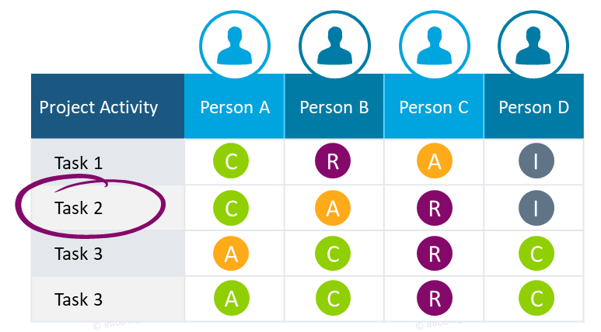
Responsibility Assignment Matrix
Responsibility Assignment Matrix (RAM), also known as
RACI matrix (Responsible, Accountable, Consulted, and Informed matrix), or
LRC (linear responsibility chart)
describes the participation by various roles in completing tasks or deliverables for a project.
Responsibility can be shared.
Accountability cannot be shared. It is something you hold a person to only after a task is done or not done.
Deliverable

Slide 18

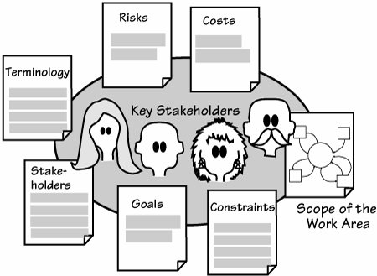

Project Blastoff Meeting [1]
Blastoff is also known as "project initiation," "kickoff," "charter," "project launch," and many other things.
The blastoff meeting prepares the project and ensures its feasibility before launching the detailed requirements effort.

Slide 19

Checklist
Why this project?
What are the problems?
What are the deliverables?
How will we solve the problems?
Technical aspects (High level solution)
Management aspects (Who is responsible for what?)
When must we complete the project?

Slide 20


Slide 21



Create a Prototype
Workflow UIs.
Prototype

Slide 22

Create a Product Backlog
Features with acceptance criteria mapped to workflows.
Product Backlog
Software Requirements Specification or Product Backlog

Slide 23

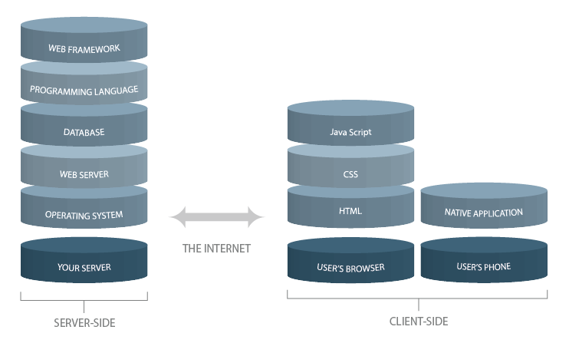

Create Architecture
Why choose this application type, this architectural style?
Why choose this technology stack?
Why choose this platform, this framework, this portal, this CMS.

Slide 24


Create a Proof of Concept
The simplest feature that demonstrates the entire technology stack.
The most difficult feature.
Problem solving

Slide 25
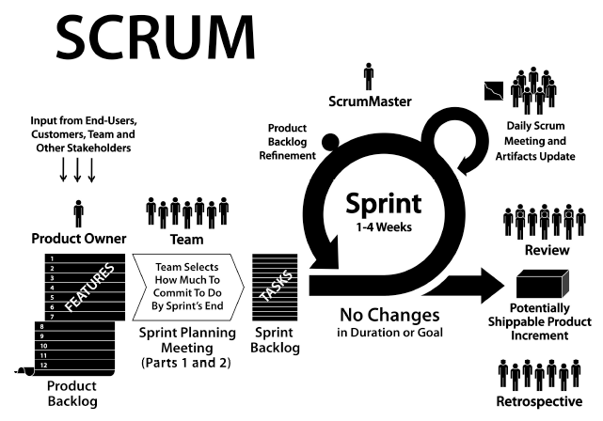
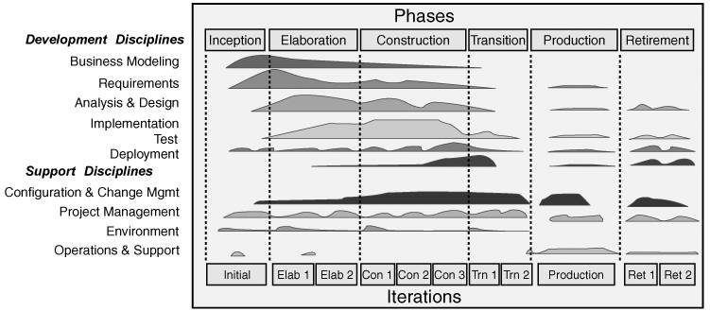
Select a Development Method
Waterfall?
RUP?
Scrum?
Kanban?
RUP (Rational Unified Process)

Slide 26

Thank You & See You Again

